Slide 1
Teaching and Writing Cases
Practical Suggestions and Check Lists for Building Ethics Cases

Slide 2

Plagio – 50
Scientific Rigor 45
Authorship 32
Record Keeping 25
Misrepresenting expertise/competence 24
Power Disparity 21

Slide 3
Robo de Ideas 20
Speculate Beyond Data 17
Amiguismo 7
Failure to Follow Through 5
Not reporting what doesn’t work 5
Publish or Perish Effects 1

Slide 4
Issues List Hits
Plagiarism (Pamela’s Case)
  Also scientific rigor and record keeping
Authorship (Swift Case)
Cases are an effective means of responding to the issues/concerns in research ethics of UPRM faculty.

Slide 5
Teaching and Writing Cases
Case Discussion helps students learn and apply ethics.
Discuss Real World cases that portray everyday situations rather than focus exclusively on big news/bad news cases.
Students will modify their moral views in response to arguments by teachers and peers.
Closure in the sense of reaching the definitive right answer is not necessary
Exposure to different arguments and practice using decision making and ethical frameworks is important.
Notes:
The Emotional Dog and its Rational Tail: A Social Intuitionist Approach to Moral Judgment
Jonathan Haidt, University of Virginia, October 31, 2000
In Press, Psychological Review

Slide 6
A Case Writing Checklist
Is the story line clear?
Does the scenario present a realistic situation?
Does the case contain the right amount of information?
Does the case raise issues appropriate and relevant to your class?
Will the case be interesting to your students?
Spend time clarifying what you want to achieve with the case?
  Refer to the moral objectives and the taxonomy referred to above
Adapted from Michael Davis, Ethics and the University, 173

Slide 7
Sources of Ideas for Cases
Issues raised in professional and occupational codes
Articles in magazines, papers, etc. related to research ethics
Research ethics textbooks: (Macrina, Potter, Whitbeck, Davis, Valero, etc.)
Onlineethics.org. (Cases in research ethics written by graduate students)
UPRM Research Issues List
Movies and Plays (The Fugitive)
See handout for online resources

Slide 8
Different Case-Based Exercises
Take the case scenario:
Steve Cashman offers Dr. Pamela Marketer a part-time job. Lauren, her friend, is working on a stream model for the Snake River in Cashman’s company. Cashman asks Pamela to help Lauren with the modeling process, and Pamela accepts. However, when Pamela asks Lauren for the re-oxygenation calculations, Lauren looks distressed; she did not do these in her study nor did she have the data to find it. Pamela consults other data for the solution, using an open book, a quadrangle, and a map. Two months later, Pamela turns in her report to Cashman. When Lauren asks whether Pamela acknowledged her methods, Pamela answers “Not exactly,” with a smile. She continues: “Careful wording is everything.”

Slide 9
Pre-Test Format
Scenario + …
Is it realistic?
Is it ethical?
Is there disagreement?

Slide 10
Gray Matters Format
Scenario + Decision Point + Solution Alternatives
1. Lauren should keep quite.
2. Lauren should go (with Pamela) and inform Cashman of the missing data.
3. Lauren should inform Cashman of the missing data without going with Pamela
(Students would evaluate and rank different solutions to problem)

Slide 11
Format used in CAW
Students analyze case using seven steps of modified method of deontological deliberation.

Slide 12
“¡Manos a la obra!”
45 minutes to write cases

Slide 13


Now it’s your turn…

Slide 14

Now its your turn to create a case
You have seen three examples
Use these as points of departure
Contextualize, contextualize, contextualize…
  Integrate with your teaching
  Show how ethical issues arise in the context
  of your field or expertise

Slide 15




Individually
  write one or two ideas on an index card
    one case / situation / concept per card
K E E P I T S I M P L E ( KISS )…
build in complexity later
10 minutes
5 minutes
READY

Slide 16



In your group
  each person presents his or her idea to the other group members
10 minutes
5 minutes
READY

Slide 17



In your group
  select one of the ideas and prepare a micro-interventions exercise to for presentation to the plenary
10 minutes
5 minutes
READY

Slide 18



5 minutes per group
  colleagues provide constructive feedback
Group 1
Group 2
Group 3
Group 4
Group 5
Group 6

Slide 19


Slide 20

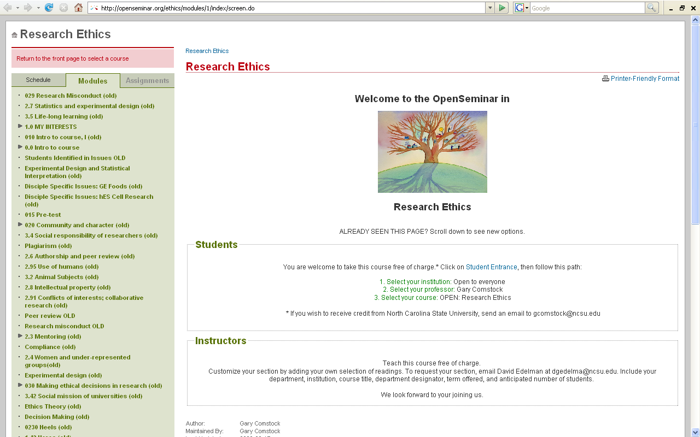
http://openseminar.org/ethics/modules/1/index/screen.do

Slide 21
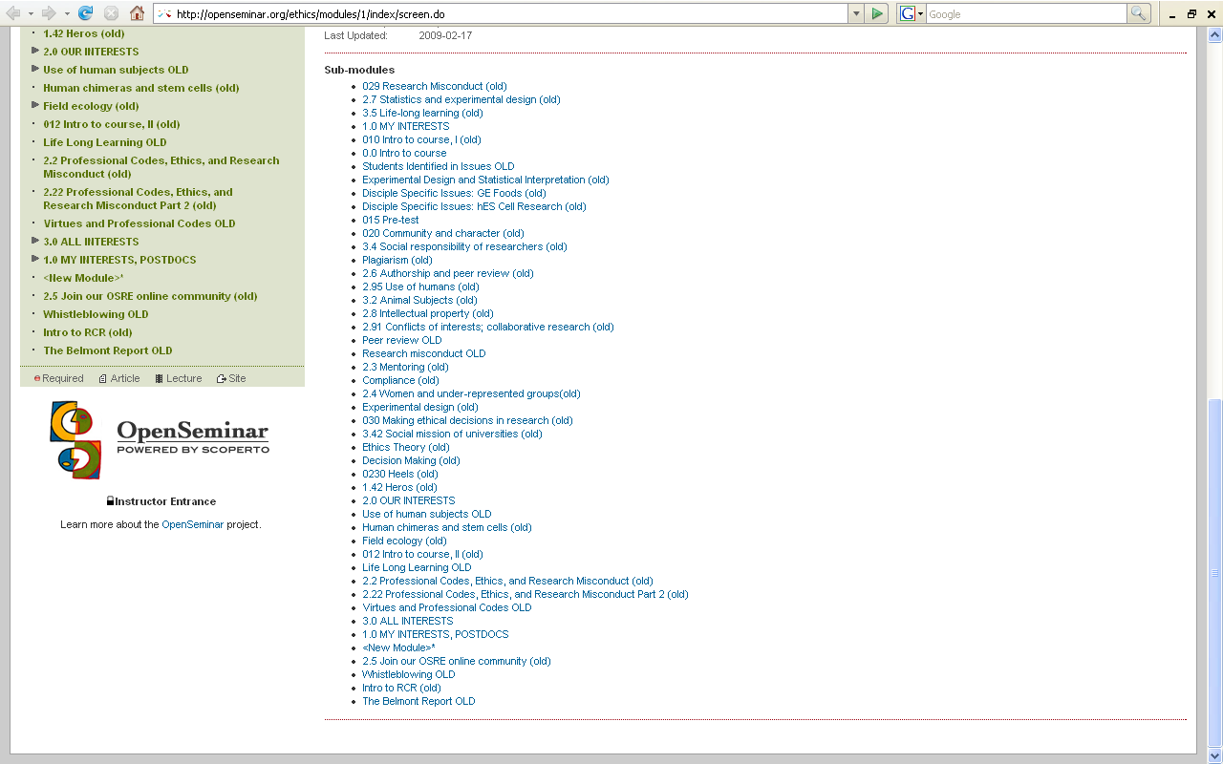
http://openseminar.org/ethics/modules/1/index/screen.do

Slide 22
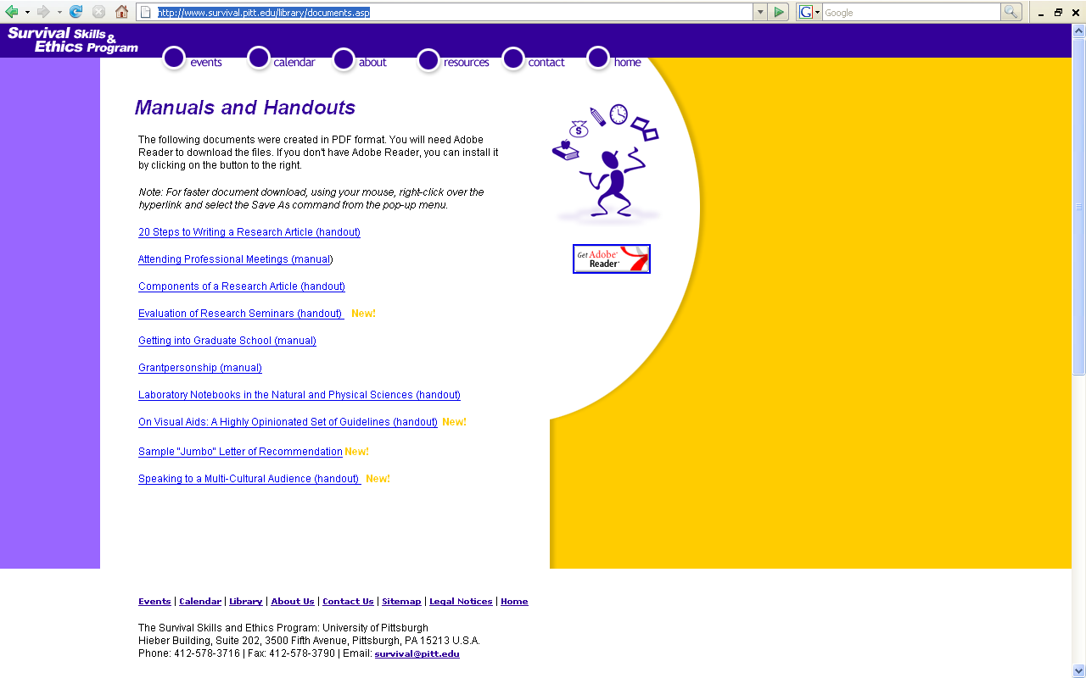
http://www.survival.pitt.edu/library/documents.asp

Slide 23
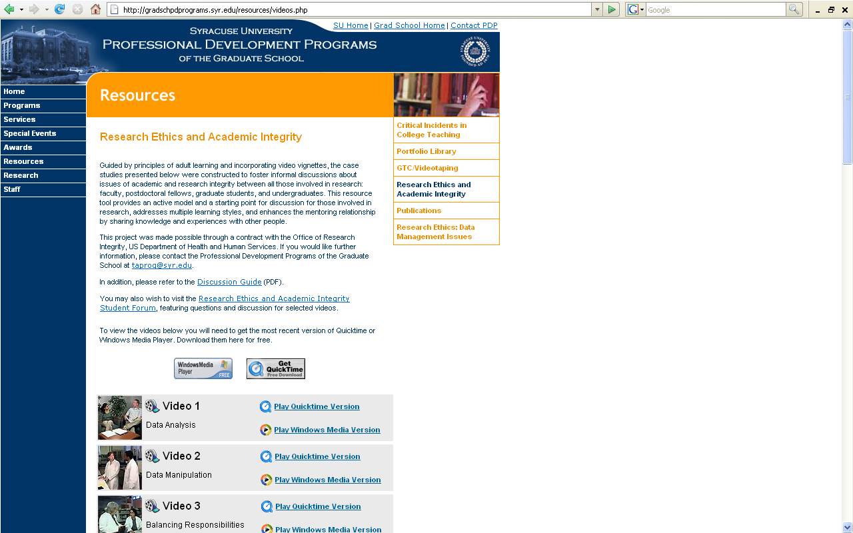
http://gradschpdprograms.syr.edu/resources/videos.php

Slide 24
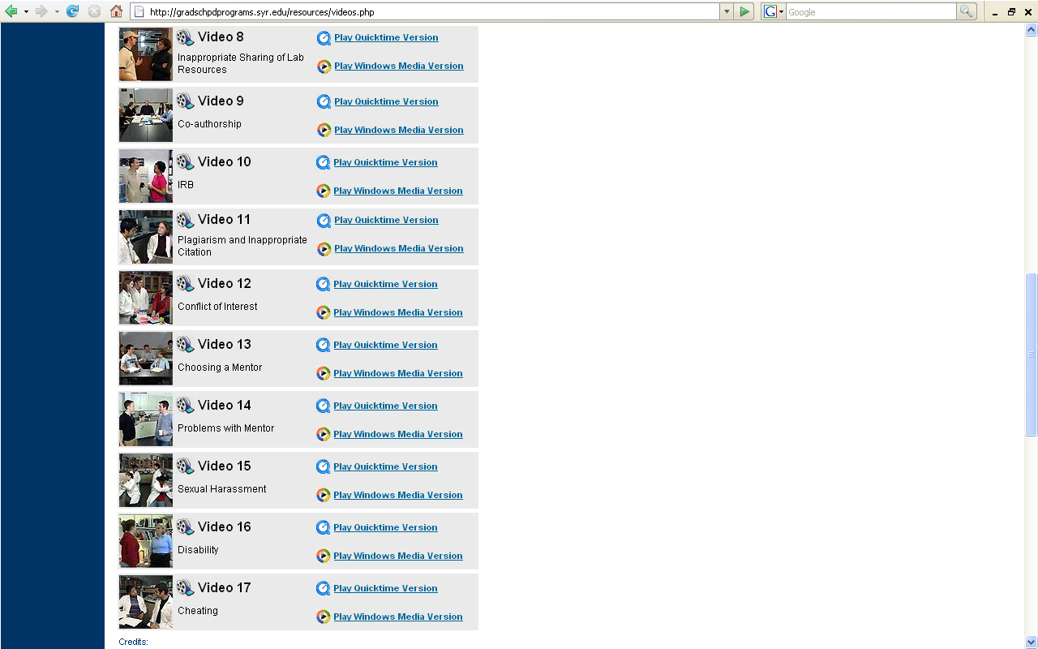
http://gradschpdprograms.syr.edu/resources/videos.php

Slide 25

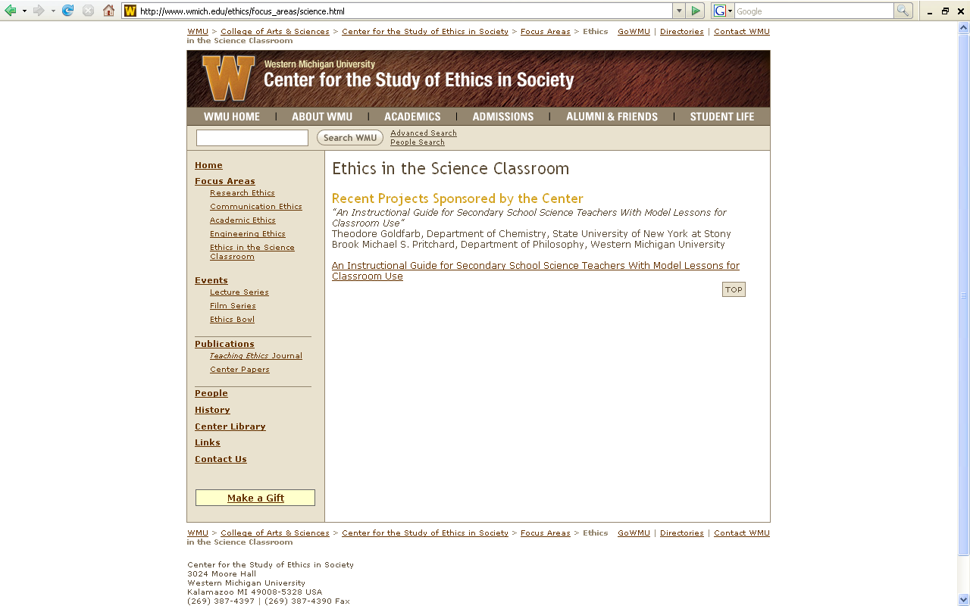
http://www.wmich.edu/ethics/focus_areas/science.html

Slide 26
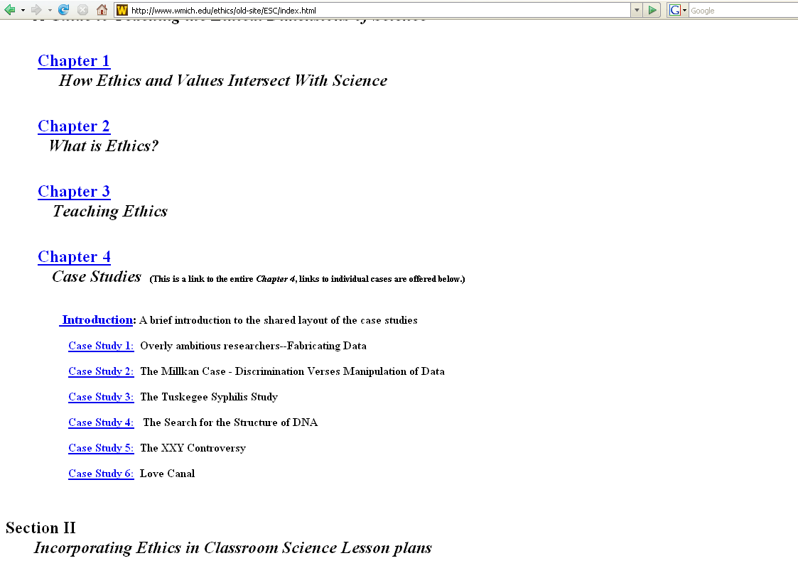
http://www.wmich.edu/ethics/old-site/ESC/index.html

Slide 27
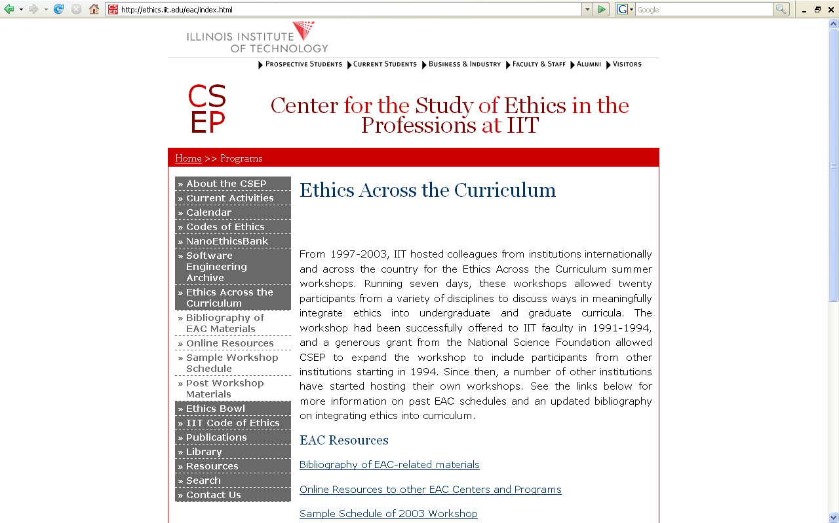
http://ethics.iit.edu/eac/index.html

Slide 28
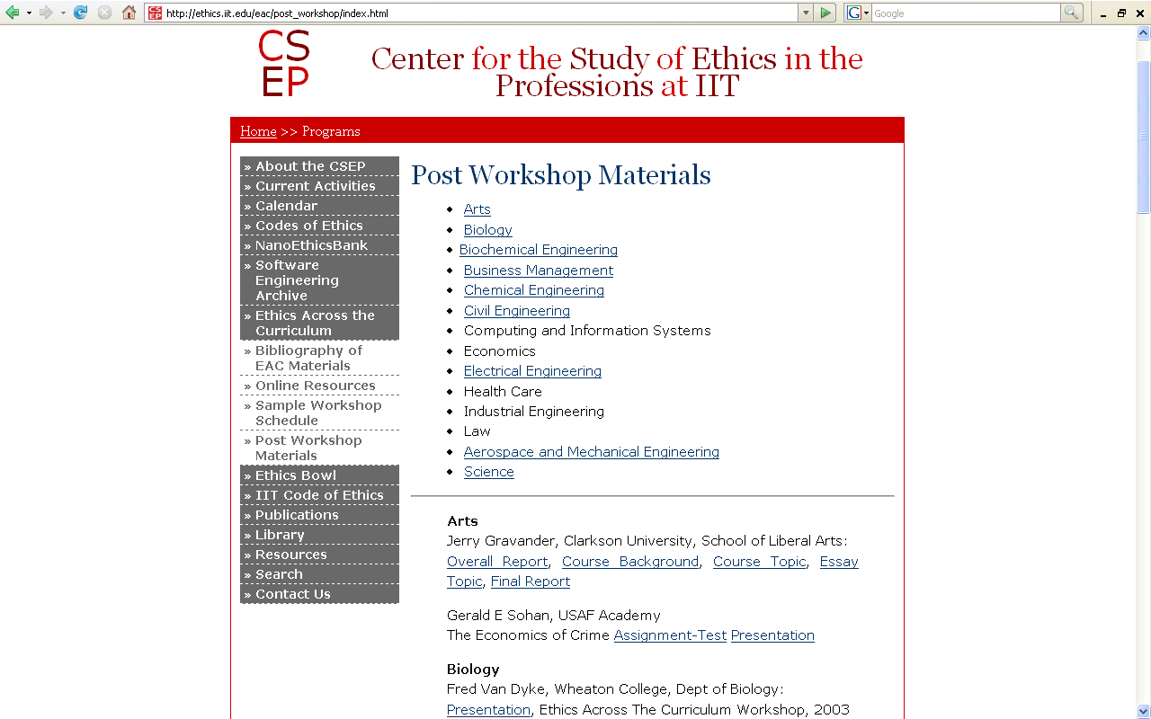
http://ethics.iit.edu/eac/post_workshop/index.html

